Slide 1
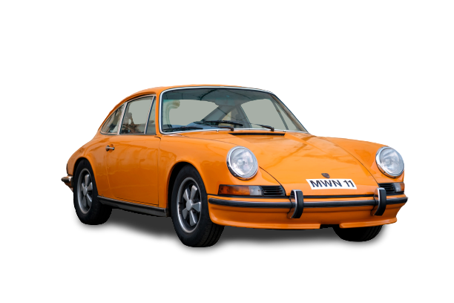
Abdillah Fikri
Kintan Pitaloka W
Rizky Muhammad K
Final PROJECT group 10
Used Car Marketplace
EQUIPPED WITH MACHINE LEARNING
Create a marketplace platform that leverages machine learning techniques

Slide 2
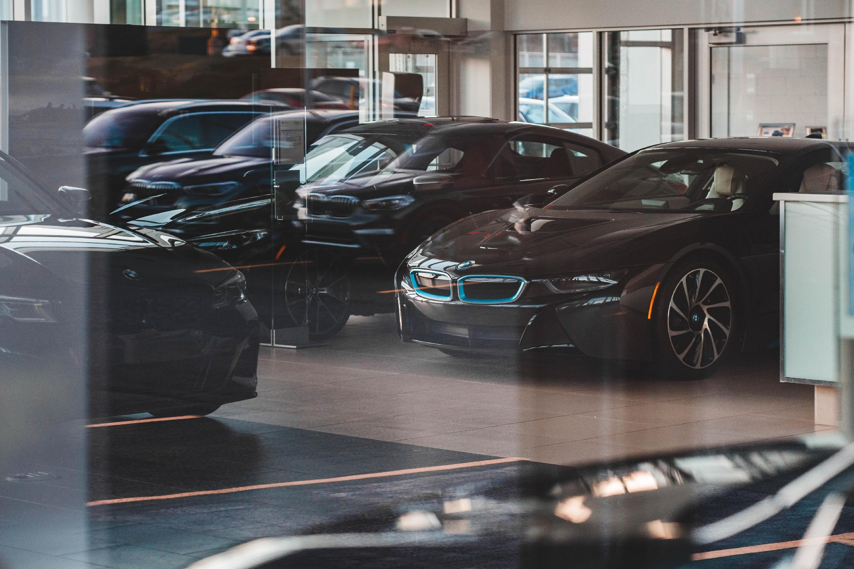
1
PROBLEM BACKGROUND
2
SOLUTIONS PROCESS
Table of
3
PLATFORM CONCEPT
content
4
MARKET ANALYSIS
5
EXPLORATORY DATA ANALYSIS
6
MODEL OVERVIEW
7
FUTURE DEVELOPMENT

Slide 3



BUYER
SELLER
Problem background
Problem background
difficult to determine the selling price
difficult to determine whether worth the price offered
$
SPENT TIME
ADDITIONAL FEE
prices are formed as a result of a time-consuming bidding process
for appraisal service, if want a decent and accurate price

Slide 4



Solution
process
No more trouble case
Shorten the overall time
$
Create competitive price
Predict with model
Create Platform

Slide 5

Platform
Seller
Platform
Feature
(automatically)
concept
Buyer
+/-
$
Max / Min
Fee Trans

Slide 6
MARKET
ANALYSIS

Slide 7
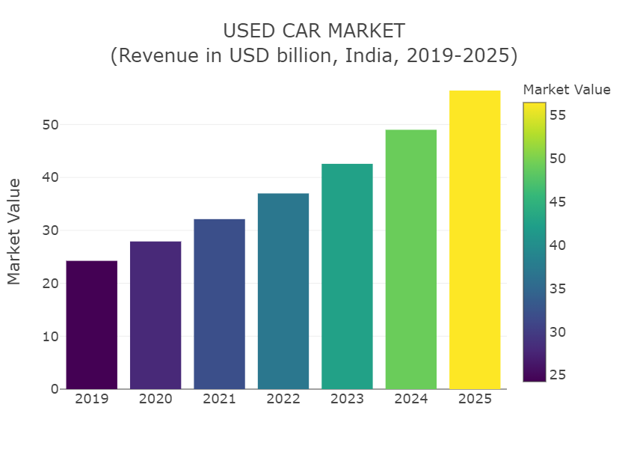
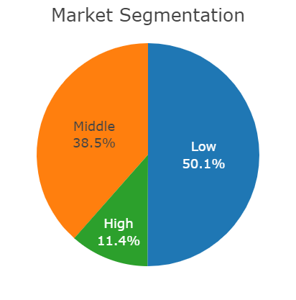
MARKET OVERVIEW
SOURCE: Mordor Intelligence
The Indian used car market was valued at USD 24.24 billion in 2019, and it is expected to register a CAGR of 15.12% during the forecast period (2020-2025).

Slide 8
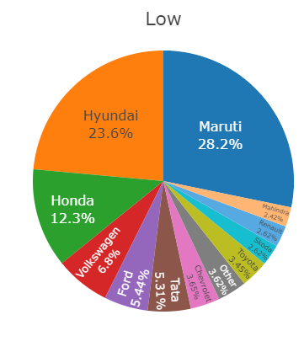
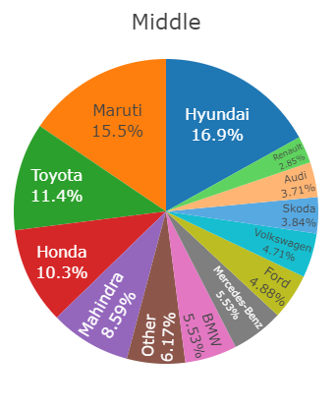
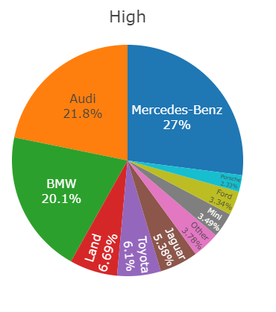
MARKET SEGMENTATION
The low and middle market is dominated by cars from Maruti and Hyundai. From the high market, there are Mercedes Benz, Audi, and BMW which dominate the market.

Slide 9
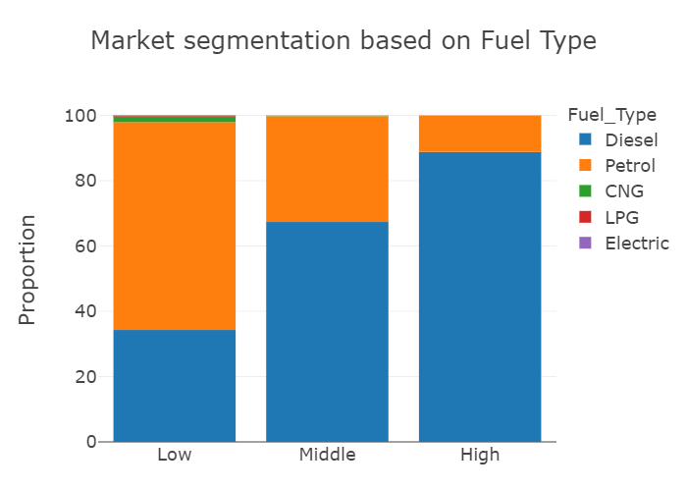
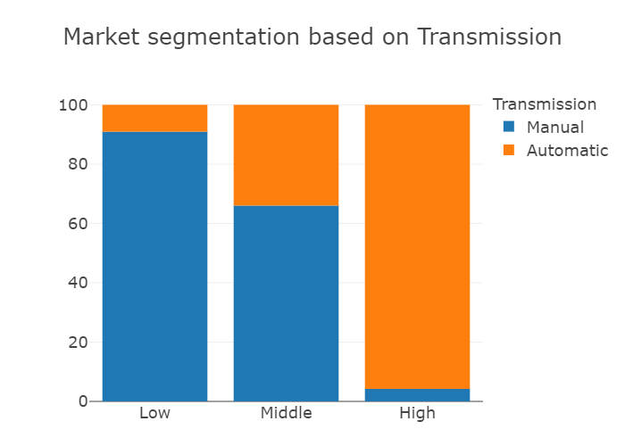
MARKET SEGMENTATION
For the low market, it is more dominant petrol fuel type and manual transmission, in contrast to the high market which tends to be more dominant diesel fuel type and automatic transmission. Meanwhile, the middle market stands in the middle of both.

Slide 10
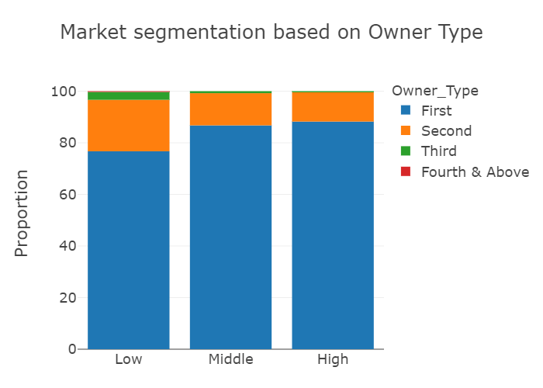
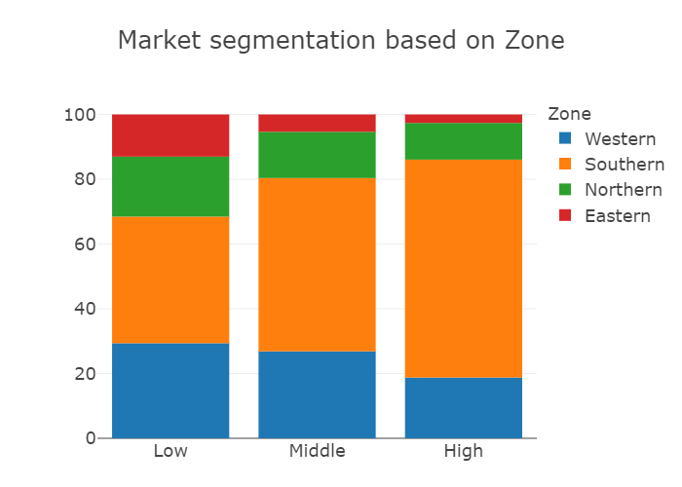
MARKET SEGMENTATION
The owner type first dominates for the low, medium, and high market even though the selling price is high compared to the owner type second or above whose selling price is lower,
and for the based on zone, seen from the proportion, the southern area is more suitable for the upper middle segment, and others are in the lower middle segment.

Slide 11
EXPLORATorY
DATA
ANALYSIS

Slide 12














FEATURES IN DATASET
Location
Year
Kilometer Driven
Fuel Type
Transmission
Owner Type
Seats
Price
Brand
Series
Type
Mileage (kmpl)
Engine (CC)
Power (bhp)

Slide 13
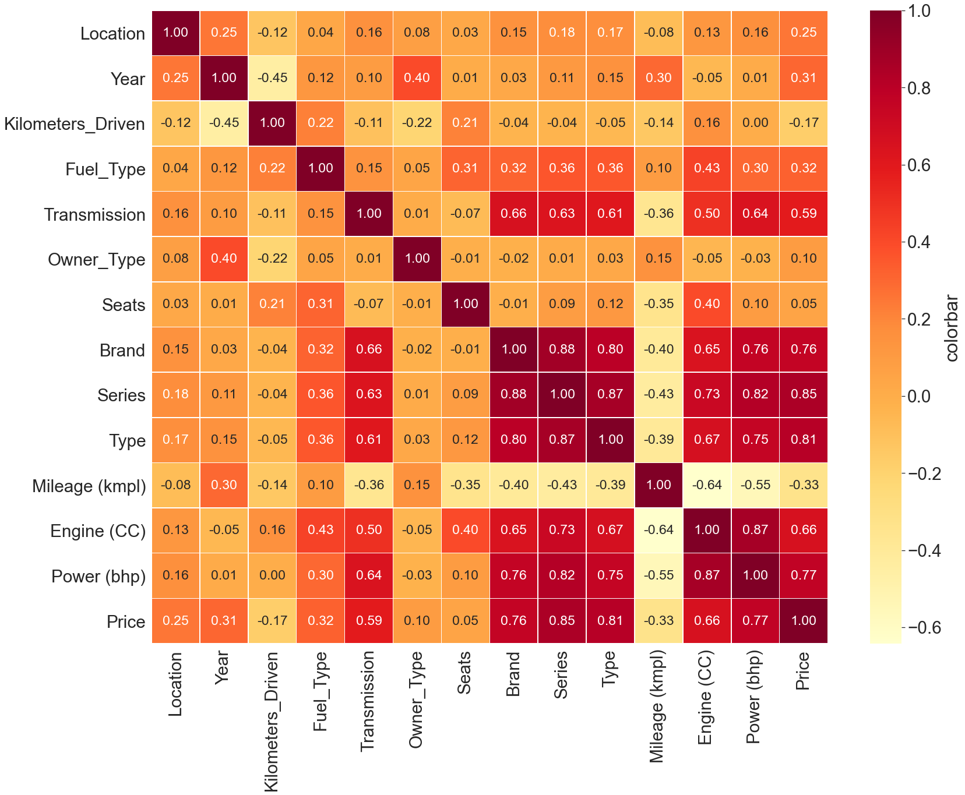
CORRELATION HEATMAP
Have strong correlation with price :
1. Series
2. Type
3. Power(bhp)
4. Brand
5. Engine (CC)
6. Transmission

Slide 14
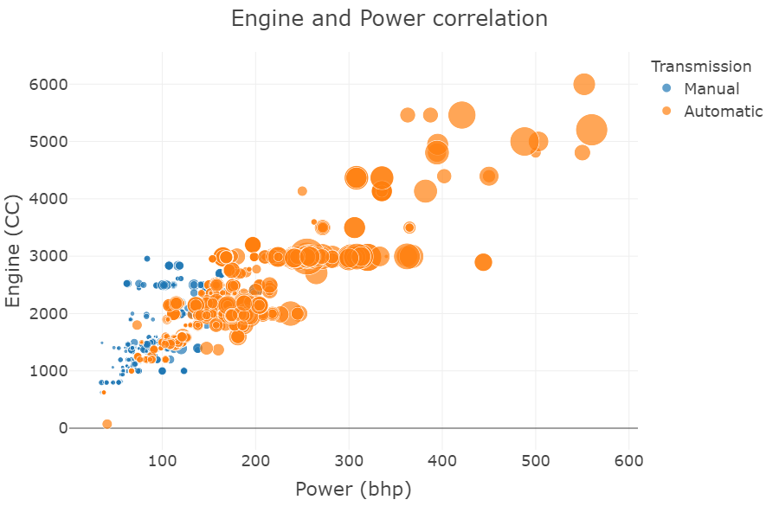
MULTIVARIABLE COMPARISON
Insight :
Engine and Power has strong positive correlation as describe in bubble plot.
Car price will getting expensive inline with Power and Engine.
Car with Automatic transmission has higher price.

Slide 15




Machine Learning which is used in modelling are Linear Model and Tree-based Model.
Model overview

Slide 16
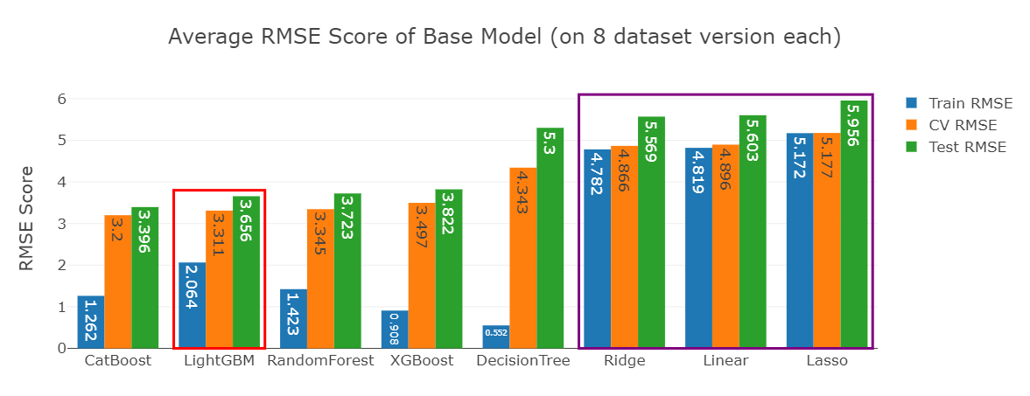
MODELS EVALUATION
From this overall scores comparison, the model with the best generalization level is LightGBM while the model tha overfit is the Decision Tree. For the Linear Model both tend to underfit.

Slide 17
PREDICT SIMULATION
Yes
Leaf 0: 8.645
Series ≤ 2.965
No
Yes
Leaf 25: 8.756
Yes
Year ≤ 2010.500
Leaf 23: 8.762
No
Series ≤ 2.646
No
Leaf 24: 8.864
Yes
Yes
Leaf 9: 8.852
Yes
Year ≤ 2011.500
No
Leaf 22: 9.023
Series ≤ 8.818
Yes
Series ≤ 4.282
No
Year ≤ 2014.500
No
Yes
Power (bhp) ≤ 107.850
Leaf 13: 9.142
No
Leaf 19: 9.447
Yes
Leaf 3: 9.9198
No
Yes
Year ≤ 2013.500
No
Leaf 14: 9.075
Yes
Power (bhp) ≤ 168.250
No
Yes
Year ≤ 2014.500
Type ≤ 21.771
No
No
Leaf 11: 9.884
Leaf 6: 11.699
Leaf 16: 10.663

Slide 18
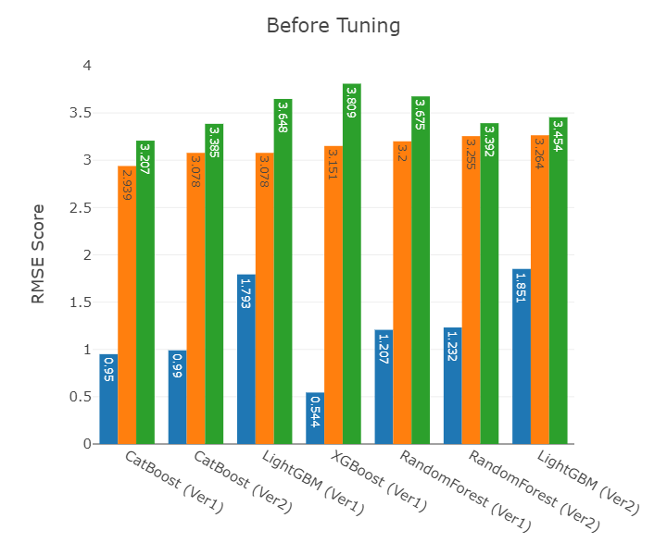
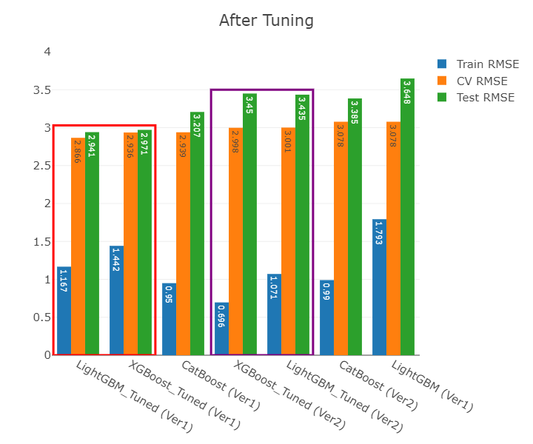
BEST 7 MODELS
Base on this results, the best model that feasible to use is XGBoost_Tuned (Ver1) because it has good overall score and better generalization compared to LightGBM one.
Notes:
Ini juga bagian angka angkanya

Slide 19
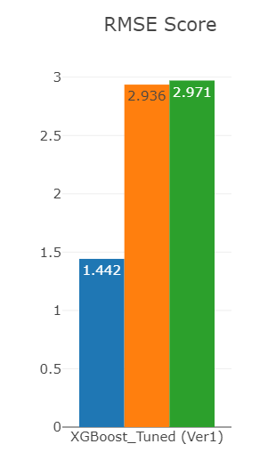
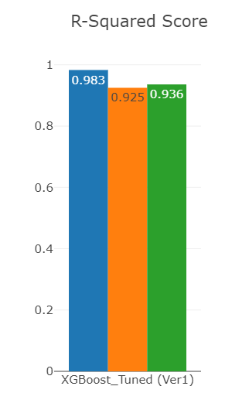
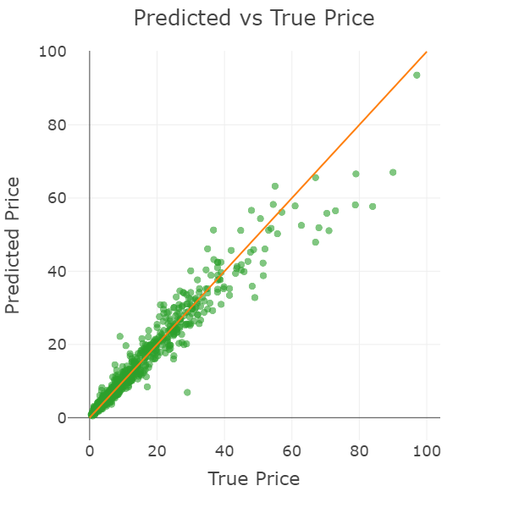
FINAL MODEL PERFORMANCE
Our final model have good performance in term of price prediction with a low error rate (RMSE) in validation and test set and high R-Squared score in validation and test set .
Notes:
Ini juga bagian angka angkanya

Slide 20
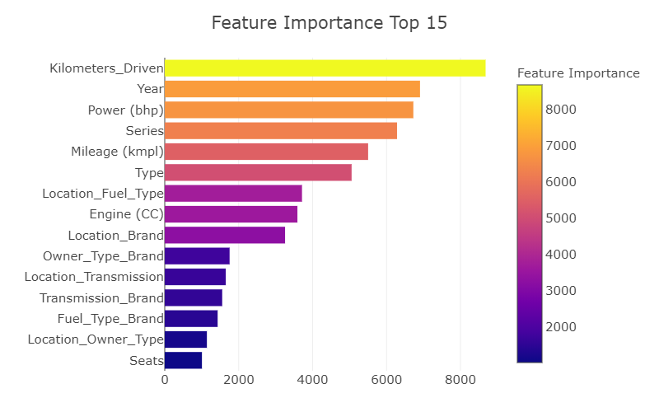
FEATURE IMPORTANCE
Feature Importance shows us which features are the most dominant in determining car prices.
Kilometers_Driven and Year have an important role to provide information of the car’s condition/age in determining car prices.

Slide 21
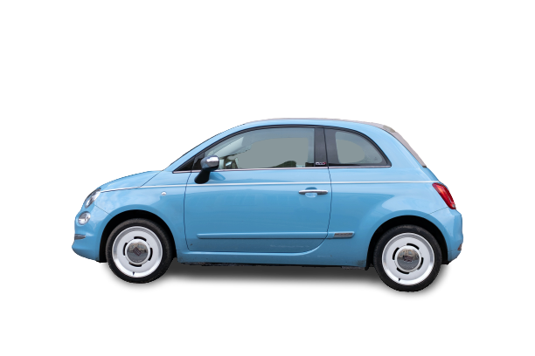

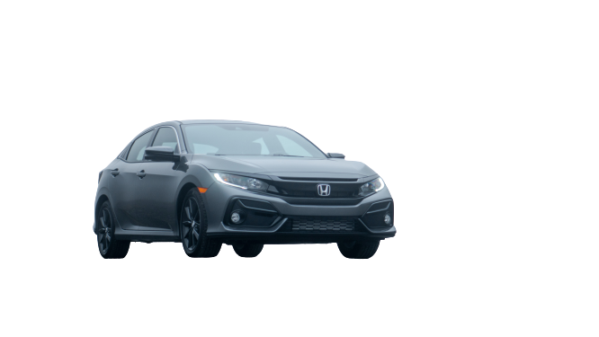
FUTURE DEVELOPMENT
Seller
Upgrade
Recommendation
+
Recommendation Engine
Platform
Buyer
Based on History
Recommendation

Slide 22
Thank
YOU

